Slide 1
Enhancing copies in the Core of Relational Databases
Authors: ESADE university
Version: 1
Date: 2022-06-13

Slide 2
Motivations
Industrial machine learning today is far from being sustainable.
How can we modify models which display several shortcomings but which have already been served into production?
How can we adapt trained machine learning models to changes in their environment? How is this problem formalized?

Slide 3
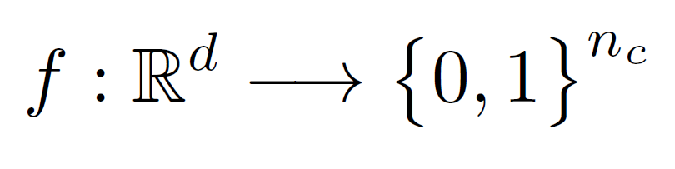
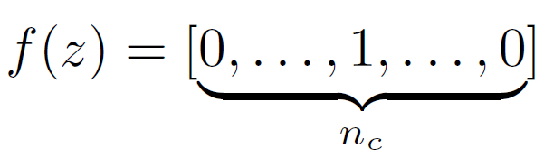
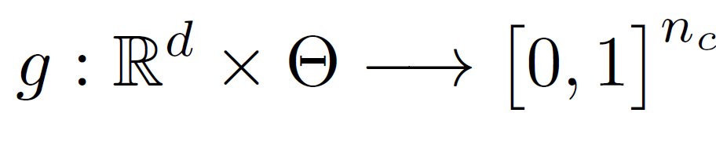
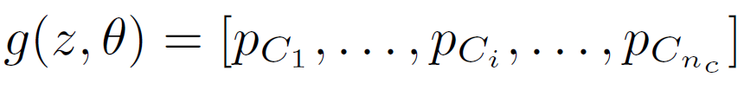
Problem Statement
The original model works as an Oracle. Maps datapoint (d-dimensional) into a binary-valued vector (n_{c} is the number of classes)
The copy is another map, whose decisión function mimics the Oracle all over the sample space. The copy retunrs a n_{c} -vector of probabilities.

Slide 4

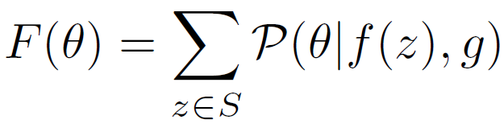
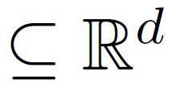
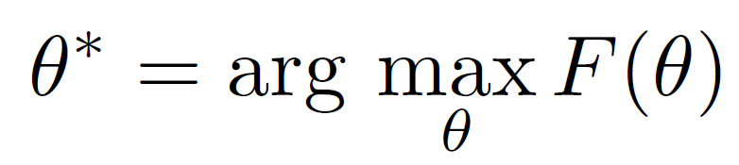
Problem Statement
Copying is characterized by the predictive distribution , which can be expressed, in its discrete form, as a new function of the copy parameters:
The problem of copyiong can be reduce to finding the optimal parameter such that the above function is maximal

Slide 5
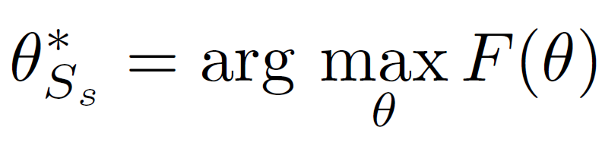
The single-pass approach
In the single-pass approach we estimate the optimal parameter set for the copy using a unique finite subset S_{s}
then, the bigger the size of S_{s} closer our estimated parameters will be to the true optimal parameters.
This apporach present some important limitations!

Slide 6
The single-pass approach: Limitations
Higher cardinality of the set S_{s} alone is not sufficient to guarantee a good approximation of the optimal parameters. There exists no effective system to ensure that the resulting set includes representative enough samples.
We are limited by the available computational resources of the system used to train the copy. The cardinality of S will be bound by the amount of memory available.

Slide 7

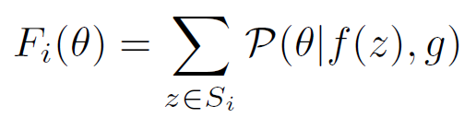

The sequential approach
The set of artificial data is constructed as a increasing sequence of subsets
The copy problem can be redefined at each step of the sequence
solving this new optimization problem
?
solving the original optimization problem

Slide 8
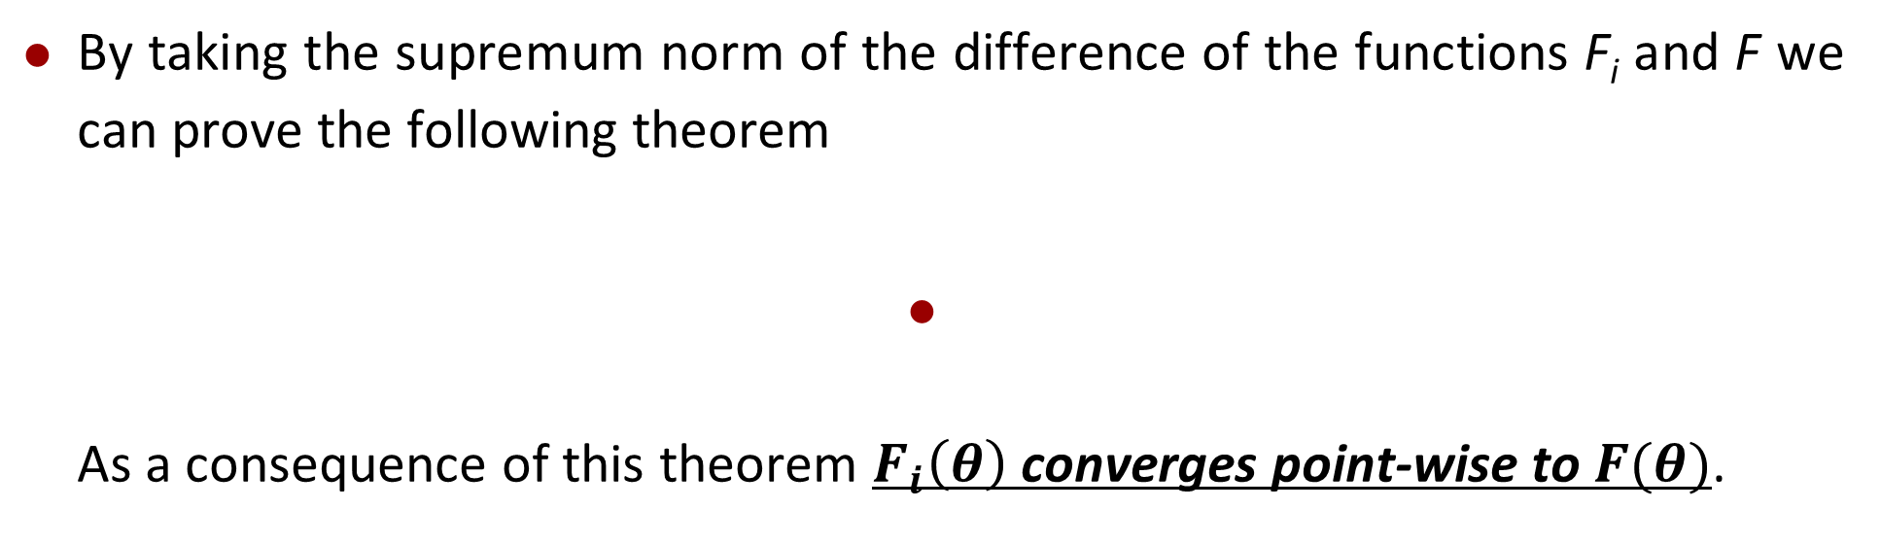
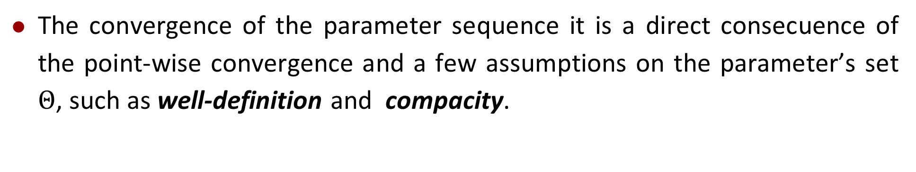
Uniform convergence for F_{i} and parameter convergence
By taking the supremum norm of the difference of the functions F_{i} and F we can prove the following theorem
As a consequence of this theorem $F_{i}\left(θ\right)$ converges point-wise to $F(θ)$.
The convergence of the parameter sequence it is a direct consecuence of the point-wise convergence and a few assumptions on the parameter’s set $Θ$, such as well-definition and compacity.
A complete proof can be found here (section 3)

Slide 9
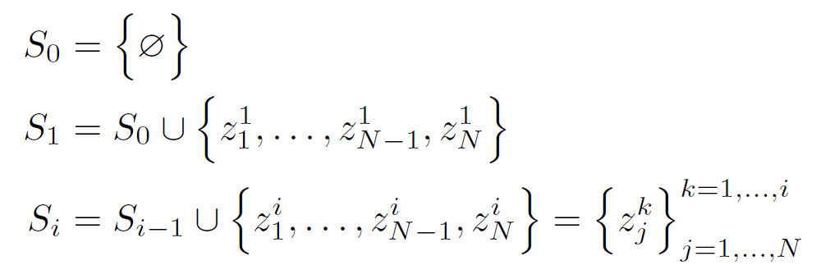
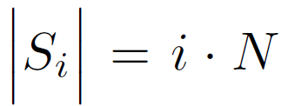
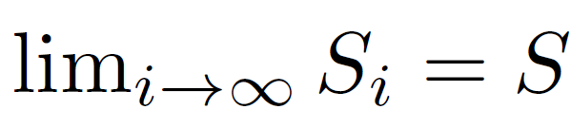
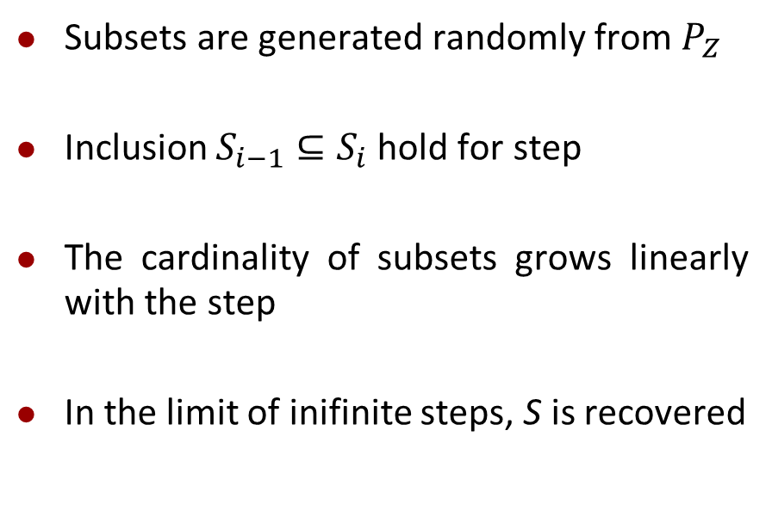
Implementation details: Building the sequence
Assuming an arbitrary generationg probability distribution over S, $P_{Z}$.
Subsets are generated randomly from $P_{Z}$
Inclusion $S_{i−1}⊆S_{i}$ hold for step
The cardinality of subsets grows linearly with the step
In the limit of inifinite steps, S is recovered
As i grows harder will be handle with the subset in practice

Slide 10
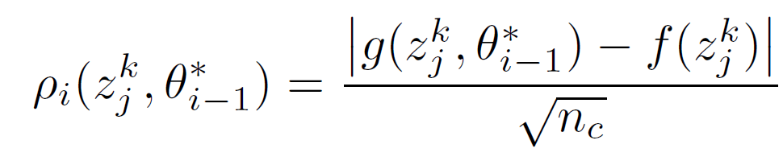
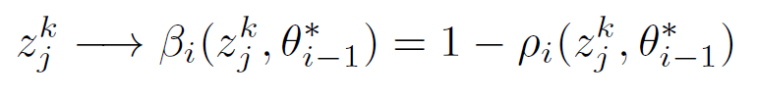
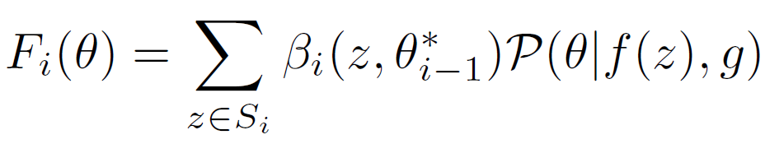

Implementation details: copy confidence
A new parameter is introduced to measure the confidence of the copy at each point. This results in a “weight” that can be used during the training
$ρ_{i}\left(z\right)∈[0,1]$
Small values of $ρ_{i}$ inidicates a strong confidence in the class prediction
Largar values of $ρ_{i}$ indicate a strong confidence in a incorrect prediction (worse scenario)
Weights can be introduced in our mathematical framwork
and convergence still hold
A complete proof can be found here (section 4.3)

Slide 11
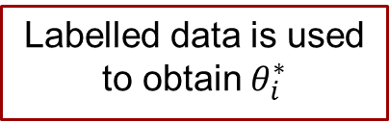
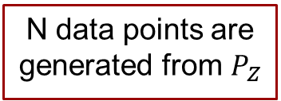

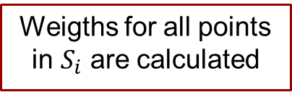
The sequential approach in practice
$θ_{0}^{∗}$ (random seed)
i=0
N data points are generated from $P_{Z}$
1
New points are labelled by the Oracle
1
Labelled data is used to obtain $θ_{i}^{∗}$
…
…
2
2
2
Weigths for all points in $S_{i}$ are calculated
2
Weigths are used to drop learned points
i=1,…,N
1 – no weighted data
2 – weighted data

Slide 12
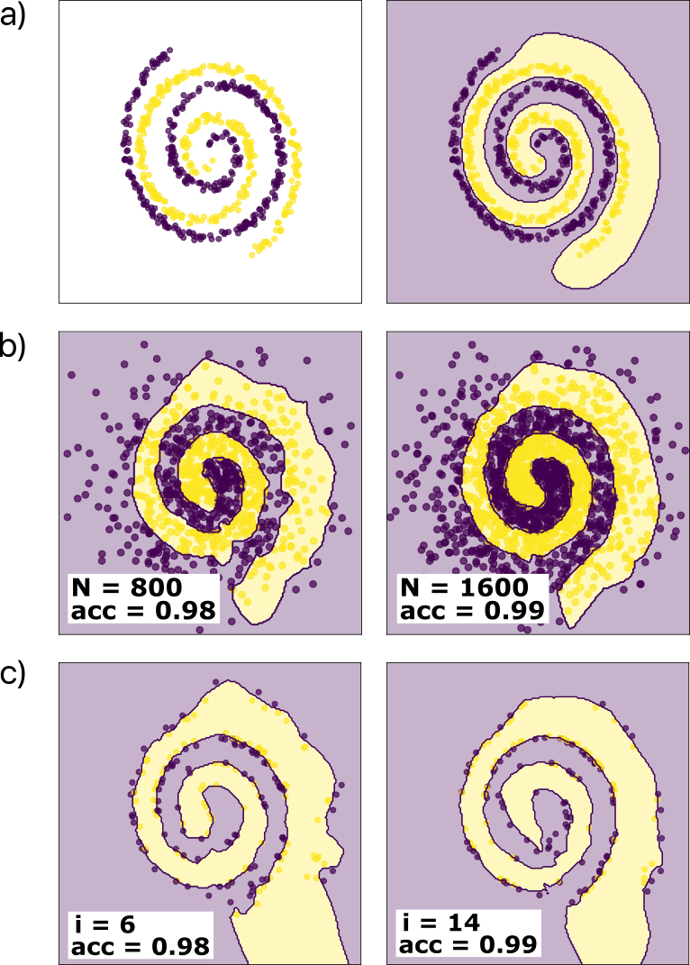
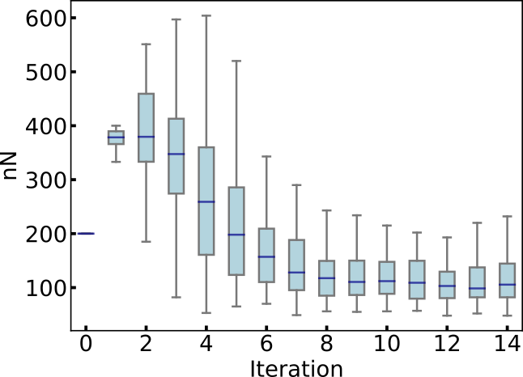
Toy problem
Sequential approach
Original data and model
Number of points at each itearation after dropping points
Single-pass approach

Slide 13
Conclusions
New mathematical framwork was developed for the copy problem
Sequential approach to the optimal solution converge
The confidence parameter can be used as weight for data points. Morevere, datapoints with large confidence can be dropped and the model still works

Slide 14
Next steps
Behavior of the confidence parameter should be analized
The concept of forgetting emerges naturally from the sequence approach. How can be characterized and mitigated?
More toy problems will be analized

